Slide 1
KANSAS HISTORY DAY AND NATIONAL HISTORY DAY 2021
Judges’ Orientation

Slide 2
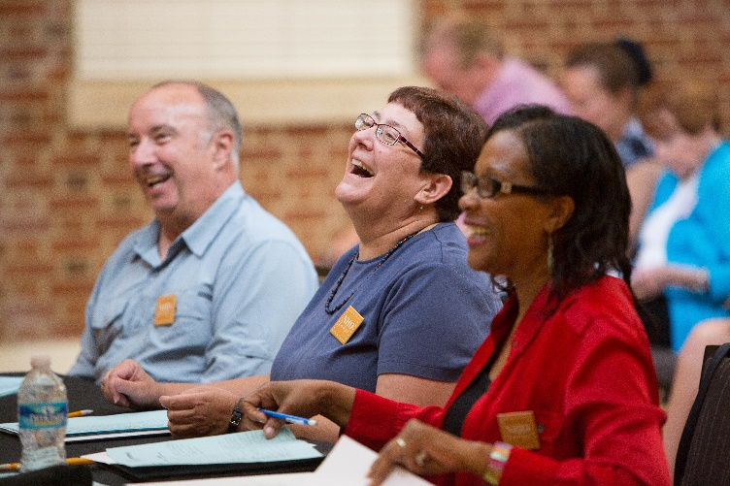
Welcome!
Thank you
for supporting
Kansas
History Day.

Slide 3
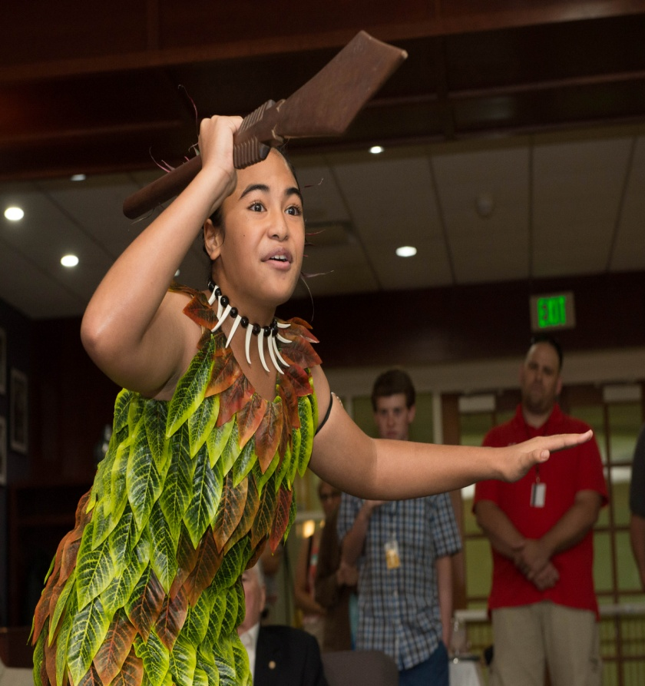
How the Contest Works
Five categories:
Paper (Individual only)
Website
Performance
Documentary
Exhibit
Individuals or groups of 2-5
Junior (grades 6-8) or Senior (grades 9-12) division

Slide 4
Contest Progression
School Regional Affiliate National

Slide 5
A Student’s Process
Topic
Research
Thesis
Analysis
Synthesis
Entry creation
Contest
Feedback
Project Life Cycle: September-June
Notes:
Let’s break it down into the process for a student.
For most kids, the cycle ends in March or April with their regional or state contest.

Slide 6
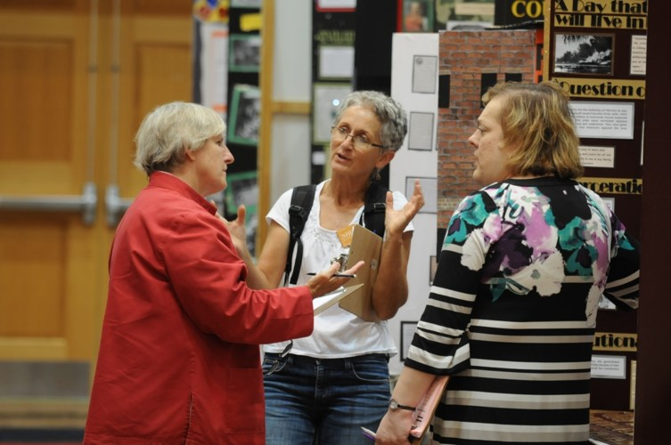
Judging Teams
Teams of two or three
The captain’s role
Your team’s goal:
achieve consensus
Notes:
The captain is responsible for guiding the team in accomplishing the necessary tasks.
You can add that “Captain” does not equal “commander.” This person is an experienced judge who guides the others on the team. He/she does not have greater power.
If a team cannot reach consensus, they should ask Rachel Goossen advice.

Slide 7
Annual Theme & Topics
Topics:
Student choice
Local, national, world history
Historical perspective is key
Students must explain the topic’s relationship to the theme and its significance in history.
2021 Theme is Communicating in History: The Key to Understanding
Notes:
To provide a focus for student research and topic selection, the NHD contest has an annual theme.
It is big and broad on purpose to give students a lot of leeway. Their task is to justify how their topic fits the annual theme and demonstrates historical significance.
Students do not have to address all aspects of the theme and should not be penalized for not doing so. Of course, some topics will lend themselves naturally to all elements.

Slide 8
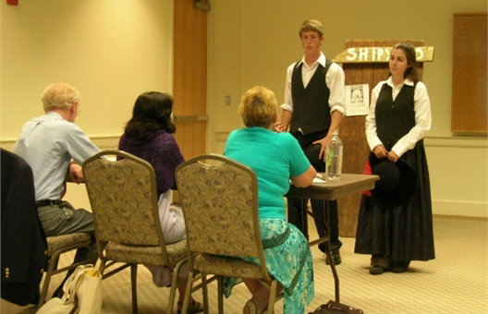
Evaluating Entries: What
Historical Quality: 60%
Accuracy
Thorough research
Primary sources
Balanced presentation
Thoughtful analysis and interpretation
Relation to Theme: 20%
Relation is adequately explained
Historical context
Historical significance
Clarity of Presentation: 20%
Effective and creative
Clear and free of errors/distractions
Notes:
The MOST important is historical quality, followed by relation to the theme.
Do NOT get hung up on clarity of presentation errors that can be fixed. Typos, glue smears, improper formatting, etc. can all be corrected before the next level.

Slide 9
Evaluating Entries: Why
Our goal is to encourage kids to keep learning by providing constructive feedback in a positive environment.
Your goal is to help us do this.
Notes:
At the end of the day, you want the students to understand why you evaluated their work the way you did. The evaluation form is your tool.
Students will review your evaluations very carefully as they try to understand why you did or did not advance their entry. Help them by checking boxes in the same range and writing clear, unambiguous and constructive comments.
If you have time, use this opportunity to briefly summarize the 2011 formal evaluation of NHD:
Students in 4 schools either did or did not participate in NHD for a year. Students did NOT self-select.
They were evaluated using standardized tests, writing samples, critical thinking exercises, etc.
The outcome – NHD students outperform their peers.
This holds true for all learning levels and for all subject areas beyond social studies.
NHD students are better writers and better at critical thinking and analysis, as well as perseverance, time management, and communication.

Slide 10
Evaluating Entries: How
Comments:
Explain your rankings through constructive and positive comments.
Phrase your comments clearly.
Explain how they can improve so they can be more successful next time.
Expect quality, but remember that you are evaluating the work of young students who are just beginning to learn historical research, project development and presentation techniques.
Deliberate together and reach consensus.
Notes:
The best practice is for each of the three judges to complete a separate evaluation form. This way, the students receive more feedback.
These forms should NOT be identical. Instead they should be complementary in tone and range, meaning that one judge shouldn’t check “superior” if the other two check “good.”
The comments must reflect the boxes that are checked. Why is it superior? What needs to be improved? And so on…
The very best, the very worst and every entry in between deserve ample comments. The students have worked literally hundreds of hours for something you will review in 15 minutes. Make it worth it to them!

Slide 11
Contest Rules
What?
Rules for all entries
Specific rules for
each category
Why?
Apples to apples
Notes:
Please take your instruction booklets with you and ALWAYS refer directly to the rules. Don’t rely on your memory.

Slide 12
 | Minor Infraction | Major Infraction | Disqualification
Definition | A violation that does not provide a competitive advantage | Exceeding any of the equalizers(time, size, words), thus creating a competitive advantage by being able to provide more information | The ONLY grounds for this are: reusing an entry from a previous year; plagiarism; tampering with another entry.
Example | School name on process paper, exceeding word count by 10 words, etc. | Exceeding words by 10+, size by 1 inch+, time by more than 5-10 seconds.
Procedure | Note these in your comments. These violations should not prevent an entry from advancing. Consider them only to break a tie between two entries that are otherwise equal. | Note these in your comments. These entries should NOT advance. If they truly are the best, please consult with NHD staff. | Please do not act on your own. Bring this concern immediately to NHD staff, who will decide if the entry should be removed from competition.
Notes:
Stress the procedural part of this process. Judges must bring concerns to Rachel Goossen’s attention. Rachel Goossen has the responsibility of verifying the accuracy of these accusations and notifying the teacher and students of the decision, Not the judges.
Please do not use the word “disqualification” in reference to anything other than the three violations that lead to disqualification. Disqualified means removal from the competition.

Slide 13
Alert Rachel Goossen When…
You suspect any of the disqualifying offenses:
Plagiarism
Reusing an entry or any part of an entry from a previous year
Tampering with another student’s entry
Please inform Rachel Goossen of any of the three above offenses.
She will determine whether to disqualify.

Slide 14
The Title Page and The Process Paper
A must for all Projects
How the students went about the research and creation of their entry
How the topic relates to the theme
Please read each process paper before viewing the entry.
Notes:
Website judges should have found the process paper AND annotated bibliography integrated into the site.
NEW Paper judges should see a process paper; the annotated bib should be attached to the paper.
The process paper should not be a research paper about the topic. It is the story of the process.
500 words max

Slide 15
Annotated Bibliography
Attached to the process paper
Two to Three sentences on how the source was used in producing the entry
Divided by primary and secondary sources
Please read the annotated bibliography before viewing the entry.
Notes:
Evaluate bibliographies based on the strength of their sources, the breadth of their research, appropriateness to the topic, and a young person’s ability to investigate the sources.
Annotated bibliographies are directly related to the criteria of historical quality - they show the extent and value of a student’s sources. They are critical and must be reviewed.
Thicker does not equate to better. Quality matters more than quantity. Depending on the topic, source availability varies.
Unsure why a student classified a particular source as primary or secondary? Comment on Evaluation document.

Slide 16
The Paperwork
Ranking Forms– Do These First!
Collaborate with judging group
Judge captain turns it in
NEW Evaluation Forms – Do These Well! Fill out completely.
Make sure to write constructive criticism!
Notes:
Consensus forms are highly recommended as a quick and efficient way to get the top entries that are advancing to the next round. But even if you don’t have categories with first-round teams and finals, these forms are still helpful as a place where judges are specifically listing the winners only.

Slide 17
Common History Day Myths
Exhibits and websites must have timelines.
Performances must have songs.
Glitz wins.
There is a winning formula.
Notes:
Regarding interviews as sources:
Oral history interviews with primary sources may add quality.
Interviews with “experts” are unnecessary.
Historians don’t interview other historians.
Students may still do this. Do not penalize either way!
Regarding a winning formula:
There isn’t one.
What you want to see is a complete presentation with a thesis (thought it’s not required to be labeled), main arguments/ideas, evidence, multiple perspectives, analysis, a conclusion, and demonstrated historical significance.

Slide 18
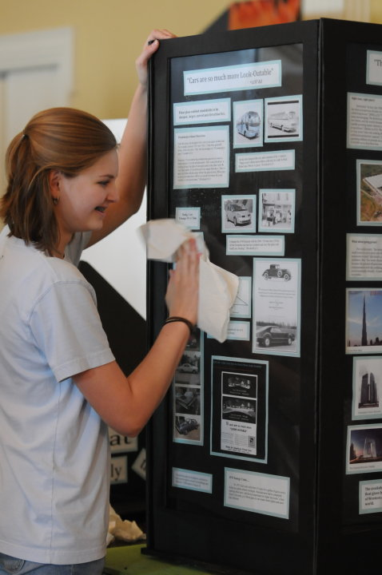
Exhibits
Size Limit
40 inches wide x 30 inches deep x 6 feet high, OR
30 inches in diameter (for 360° displays)
Word Limit
500 student-composed words
Media
No longer than three minutes
Credits
Credits of visual sources required
Notes:
Exhibits document should have title page, process paper, annotated bibliography and exhibit slides in one document.

Slide 19
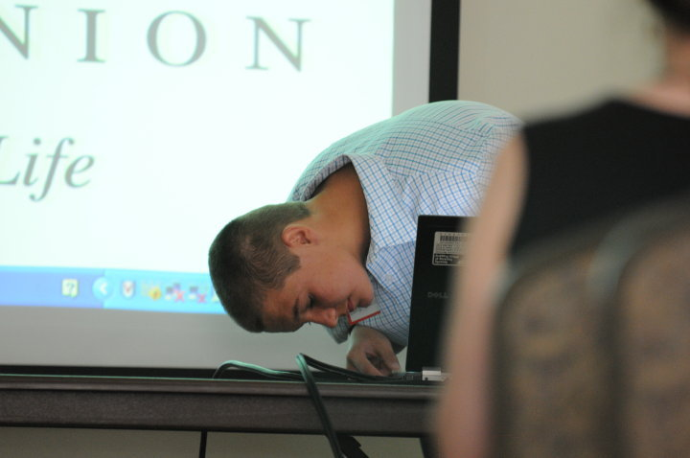
Documentaries
Time Limit
Film: 10 minutes
Speaking
Introduce title and student(s) name(s) only
Production
Students: narrate, interview, produce, edit
End Credits
Required, but must be readable
Notes:
Should be a documentary, something you might see on PBS or HISTORY^{R}. It should not be simply a performance on videotape.

Slide 20
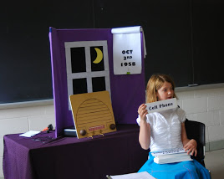
Performances
Time Limit
Performance: 10 minutes
Introduction
Title and student(s) name(s) only
Costumes
Students: design, fabric choice, etc.
May be rented or bought
Notes:
Must be original – they cannot use something that is already written.
Performers should display stage presence, including clear & audible voices.
Costumes should be appropriate for the topic and not confuse or overpower the performance.

Slide 21
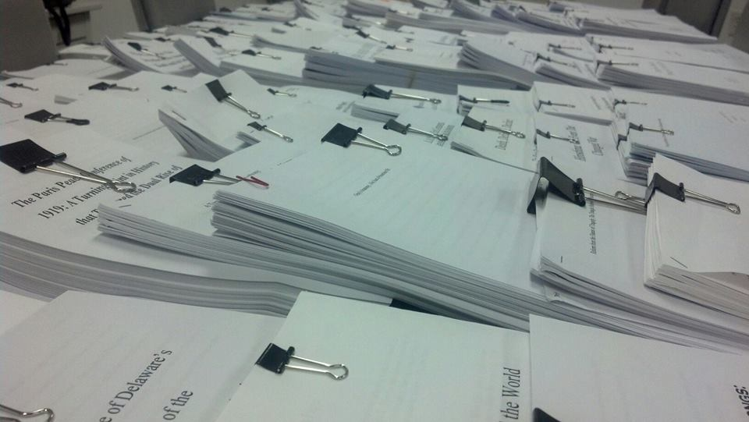
Websites
Contact Rachel Goossen immediately if website link is not working.

Slide 22
Historical Papers
NEW (2021) to Historical Papers:
Must have a process paper.

Slide 23
THANK YOU!!!
Thank you again from everyone at Washburn University, Kansas History Day and National History Day!

